Slide 1
Session 7
Understanding the Figma Tool

Slide 2
Learning Objectives
Identify the usage of the Figma Tool
List the steps to set up a Figma Account
Explain the Figma interface
Describe how to manage Figma Components
Explain the process to create a first design in Figma

Slide 3



Introduction to Figma Tool
A UI and UX design application
Compatible with most file formats
Figma editor includes design tools
Useful for designers to share files and collaborate on a design

Slide 4
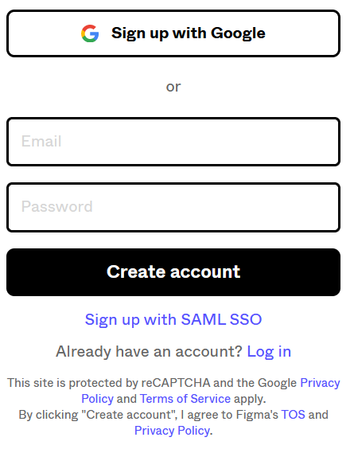
Setting Up A Figma Account
Setting up an Account

Slide 5

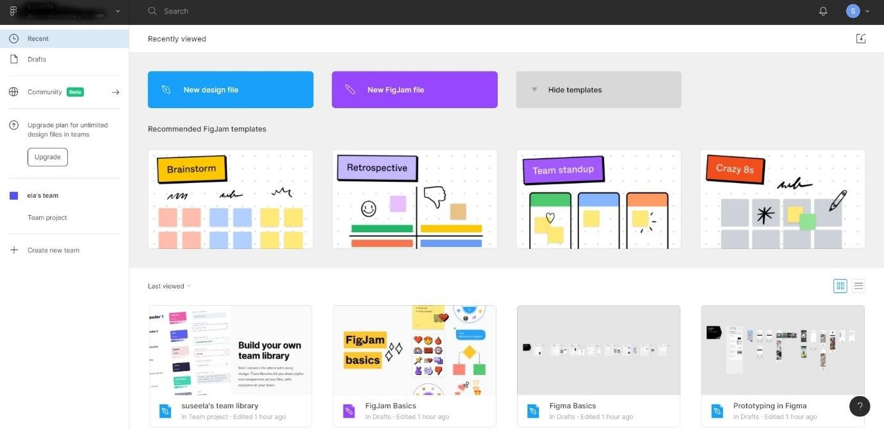
Understanding the Figma Interface
1-2
The Figma Dashboard

Slide 6
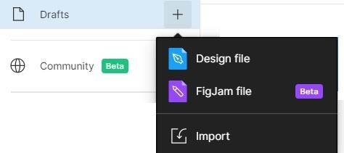
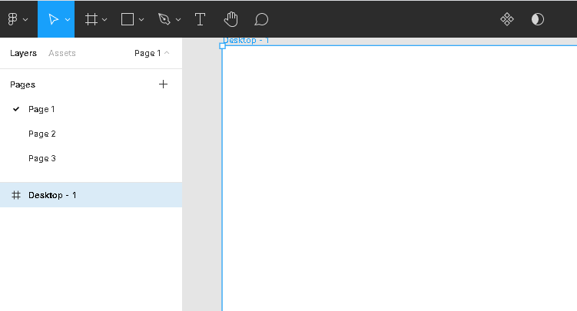
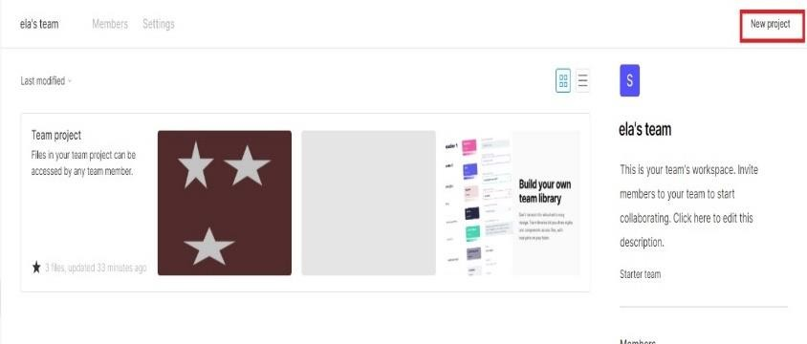
Understanding the Figma Interface
2-2
Files
Pages
Projects

Slide 7
Features of Figma
2-2
Managing Components
Adding Lists
Connecting with other Figma Accounts
Using the Inspect Tab
Using the Instance Swap Menu
Viewing Figma Community Files and Plugin Library
Integrating Zeplin
Updating Projects Real- time
Intuitive Prototyping
Sharing Design Feedback

Slide 8





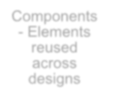







Managing Figma Components
Create and manage consistent designs across projects
Components
- Elements reused across designs
Update components across designs
Stored in
Assets tab

Slide 9
Creating a Design in Figma
1.
Creating a Frame
Adding Grids
Adding Shapes
Adding Images
Adding Text
2.
Labeling Elements
Avoids confusion due to overlapping frames and layers.
3.
Creating Groups
Organizes designs.

Slide 10





Summary
Figma is a cloud-based UI/UX design tool with capabilities to generate codes, support interactive prototyping, and create mockup.
Figma is a browser-based tool, compatible with any OS, and is used to design vectors, applications, and screens.
Figma supports the idea of teamwork and collaboration. It allows multiple team members to work on a single project in real-time.
Figma follows a four-level file structure.
Figma Editor is a modern design tool that provides options to customize designs as
prototypes.
Prototypes can be shared over real-time with team members and reviewed simultaneously. Draft files are saved automatically on the cloud for easy retrieval.
The Layers and Properties Panel on either side of the frame help in customizing a design and viewing codes.
Multiple pages can be created in Figma and collated into a bigger project.

